Slide 1
ITSC 2214 Data Structures & Algorithms
Peer Instruction Quiz
Module 1: Abstract ADT & Generics

Slide 2
Agenda
Make sure that you are using your UNCC id to get credit.
Quiz scores will be uploaded to Canvas every week
TALK TO EACH OTHER!

Slide 3
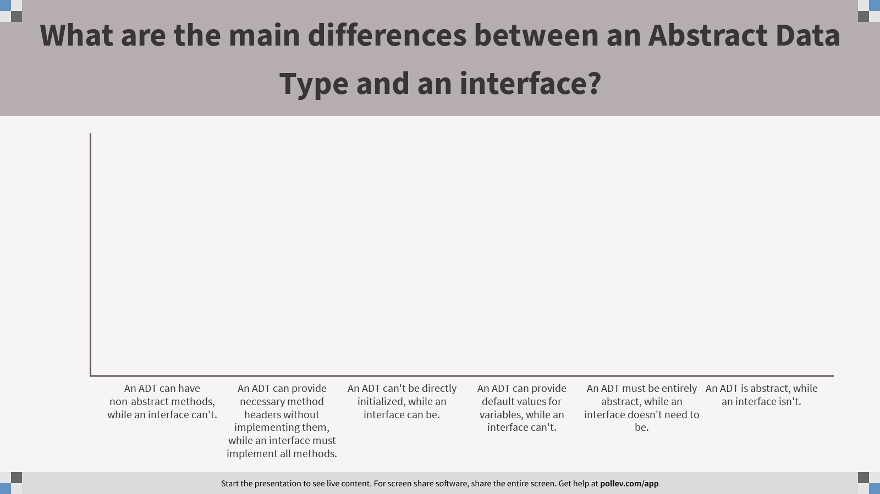
What are the main differences between an Abstract Data Type and an interface?
Notes:
Poll Title: What are the main differences between an Abstract Data Type and an interface? https://www.polleverywhere.com/multiple_choice_polls/ZYD82Z08hbO3FwlqWTP75?flow=Default&onscreen=persist

Slide 4
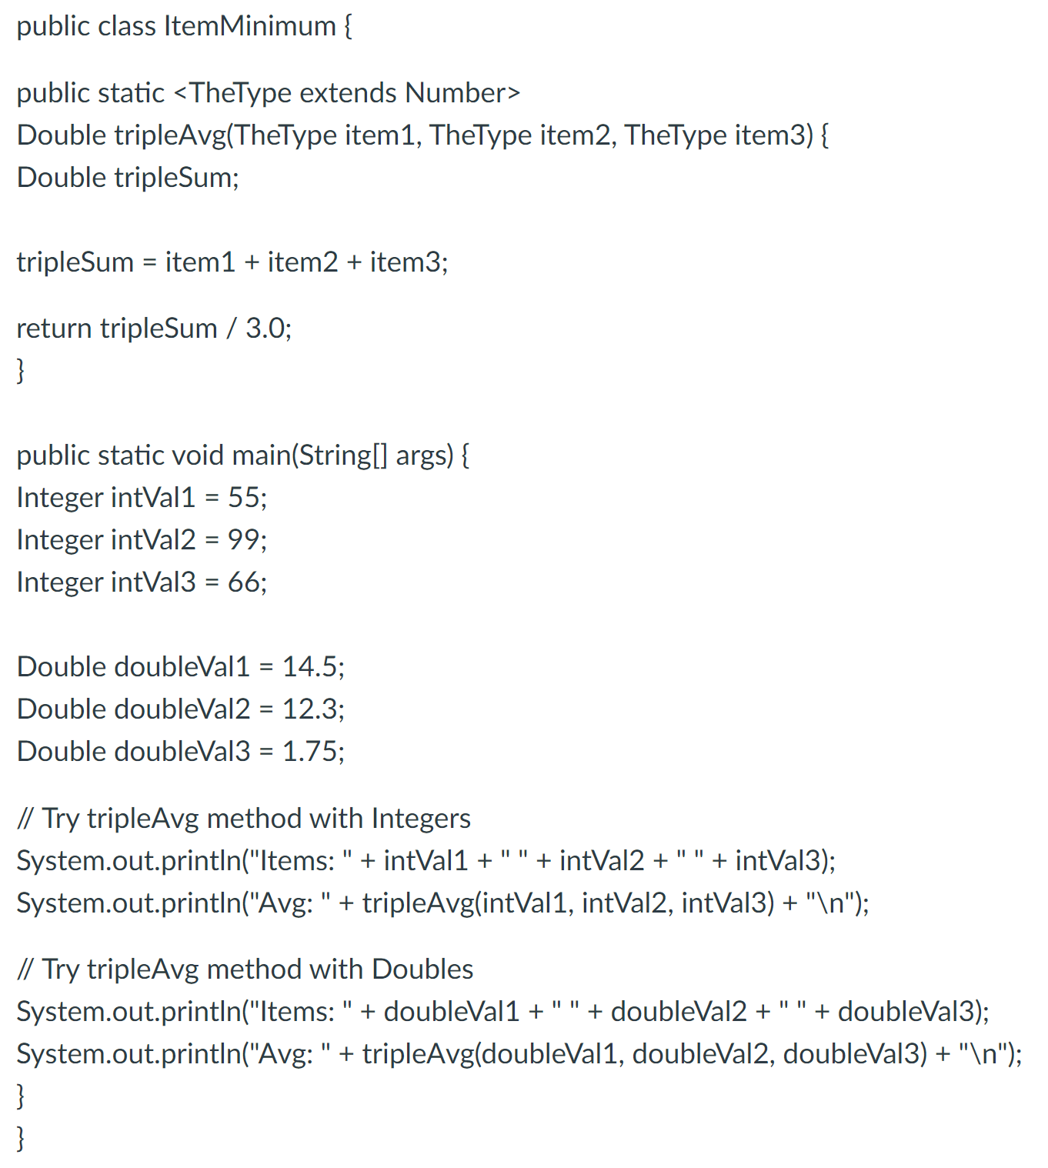
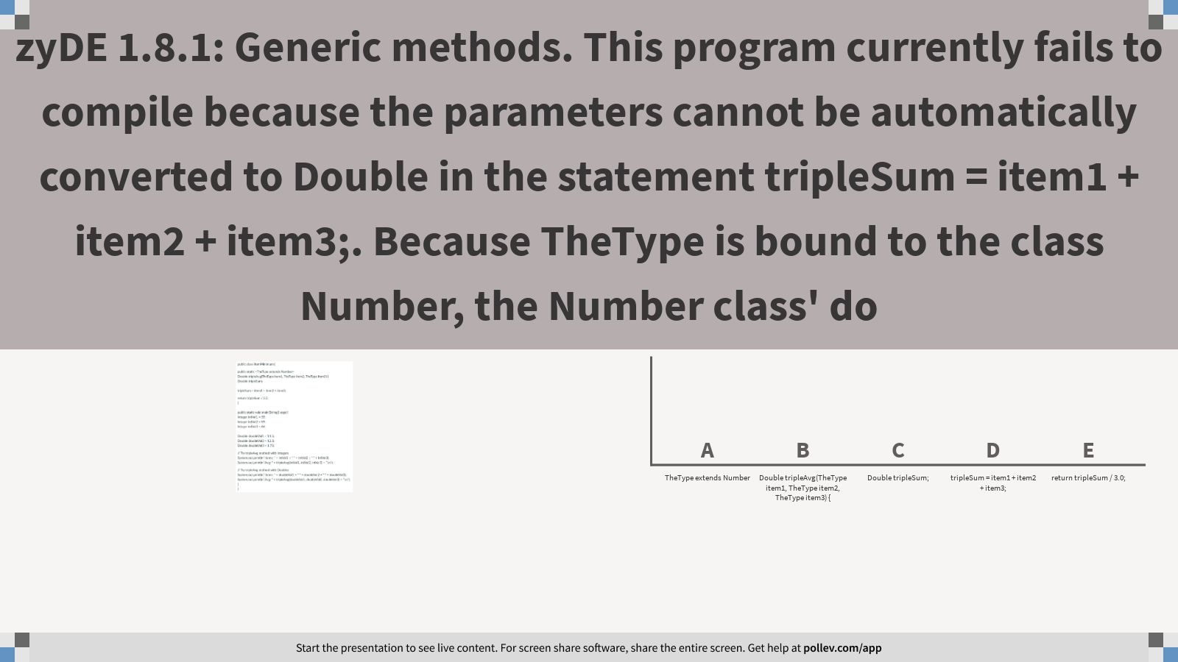
Notes:
Poll Title: zyDE 1.8.1: Generic methods. This program currently fails to compile because the parameters cannot be automatically converted to Double in the statement tripleSum = item1 + item2 + item3;. Because TheType is bound to the class Number, the Number class' do https://www.polleverywhere.com/multiple_choice_polls/5f8uzv67JQw1y7OlmroDm?flow=Default&onscreen=persist

Slide 5
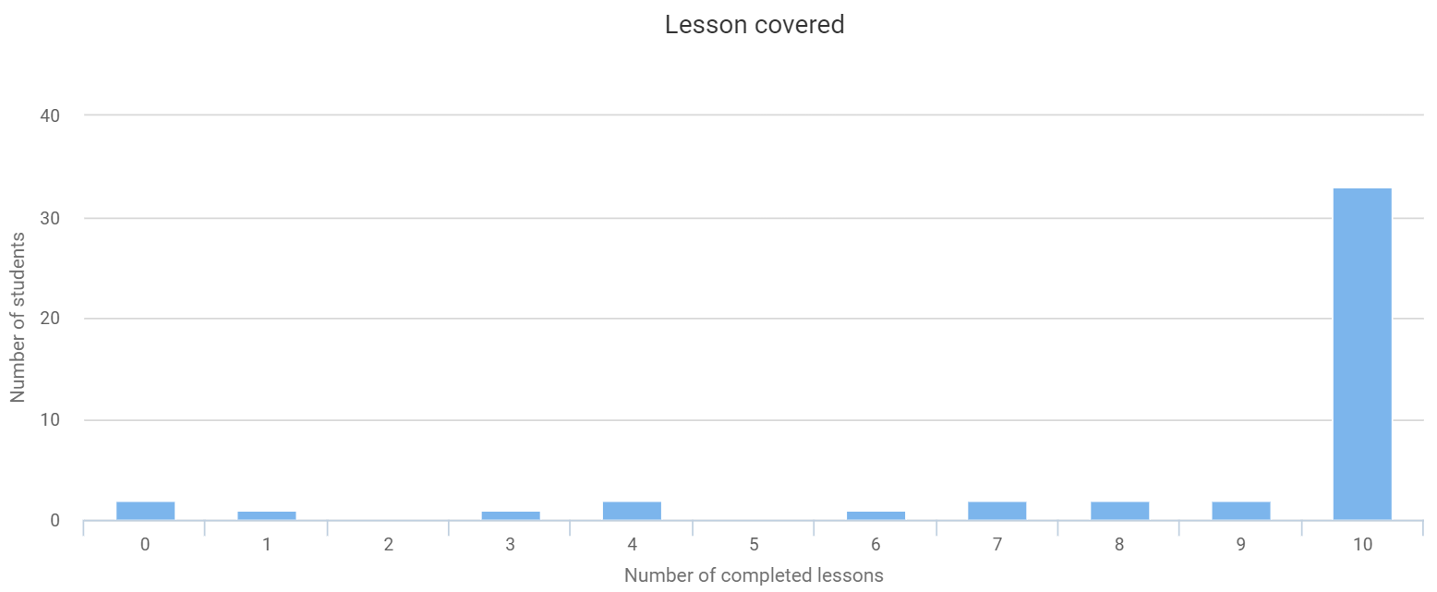
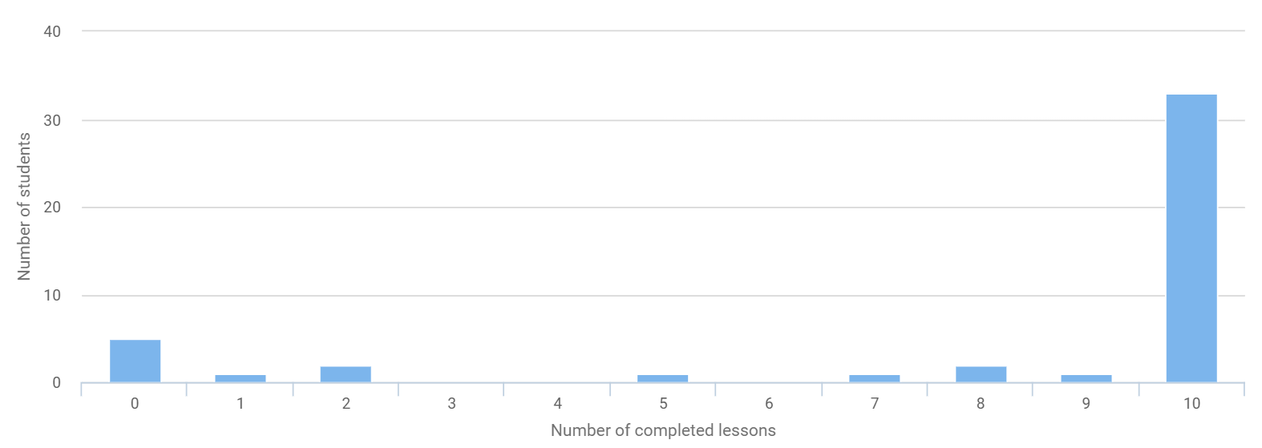
Lesson Covered
Total students: 88
#(students who finished all nodes): 68
Total completed items: 765
Y03
Y04

Slide 6
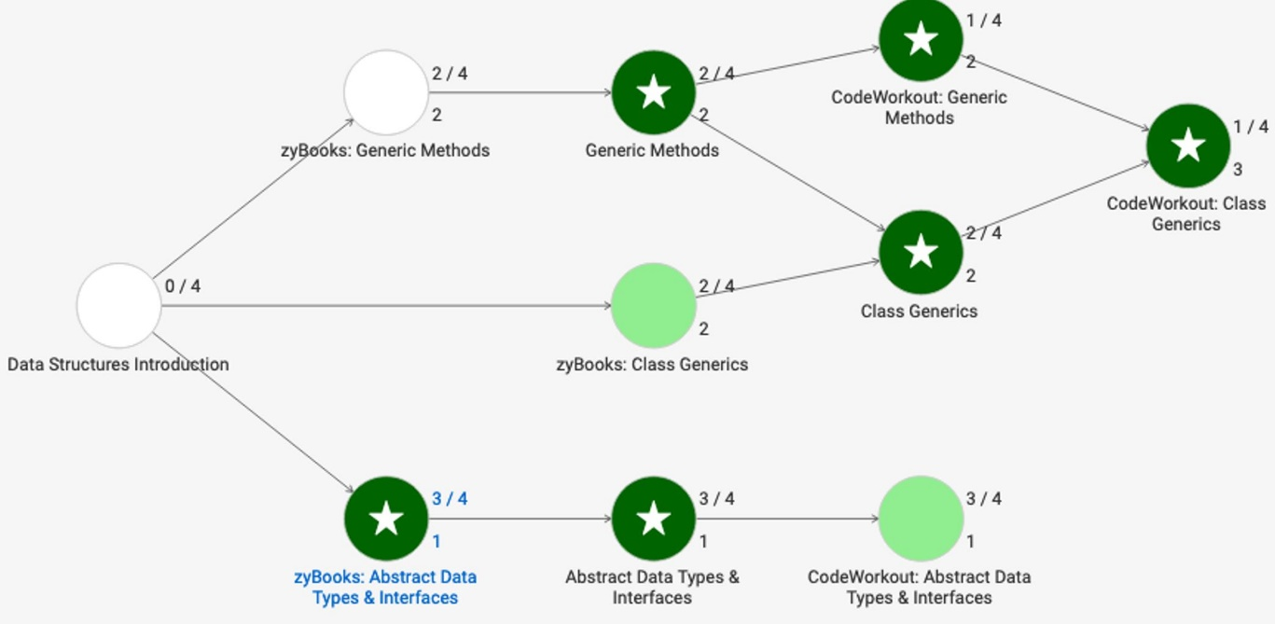
71
78
78
68
66%
66%
72%
84
62%
72%
79%
67%
79
73
83
75%
73%
65%
Yellow box: #(students who finished the node); Light green box: average ability and performance

Slide 8
ADT versus Interface

Slide 9
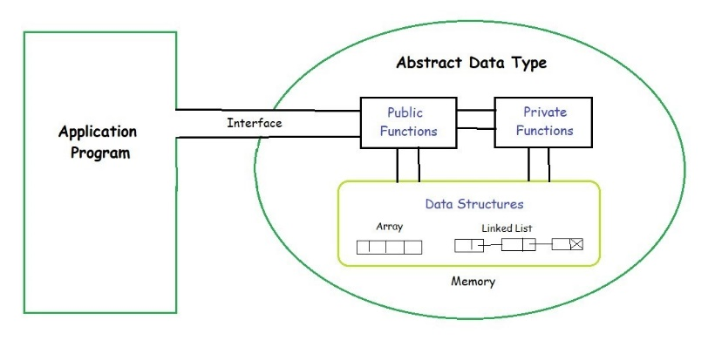
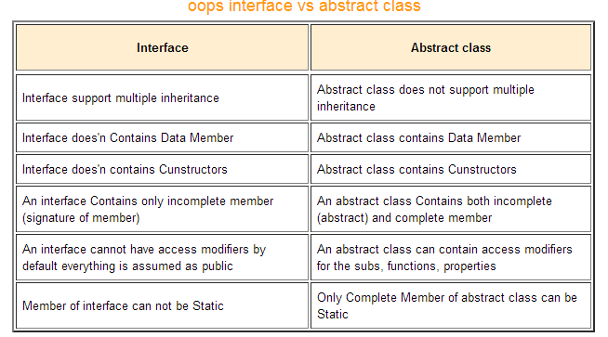
The definition of ADT only mentions what operations are to be performed but not how these operations will be implemented. It does not specify how data will be organized in memory and what algorithms will be used for implementing the operations. It is called “abstract” because it gives an implementation-independent view. The process of providing only the essentials and hiding the details is known as abstraction.

Slide 10
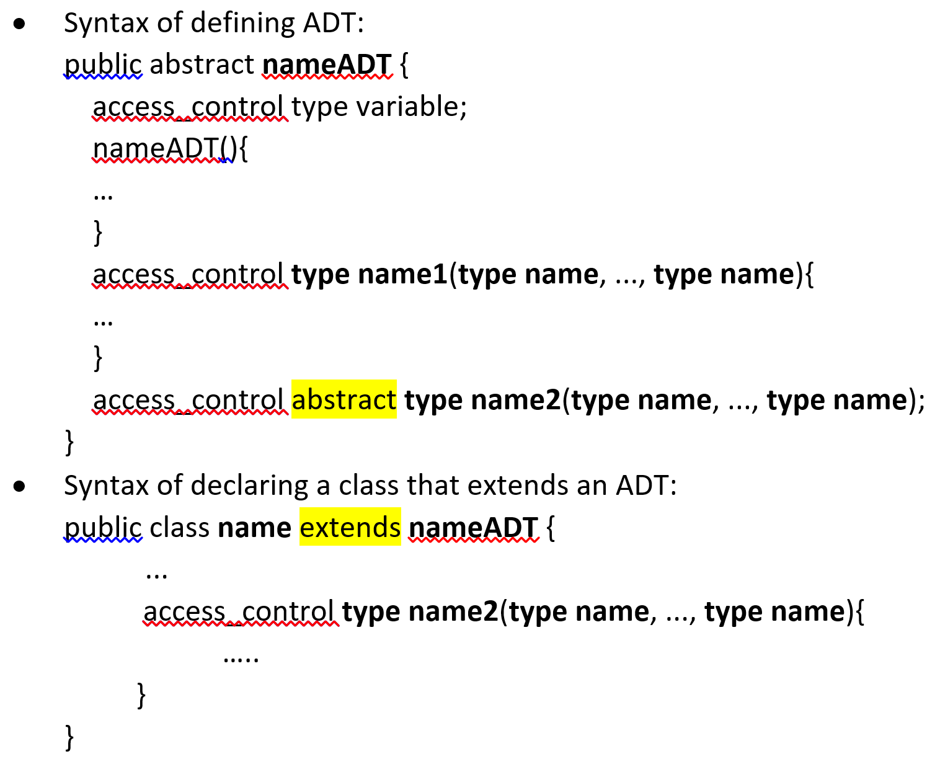
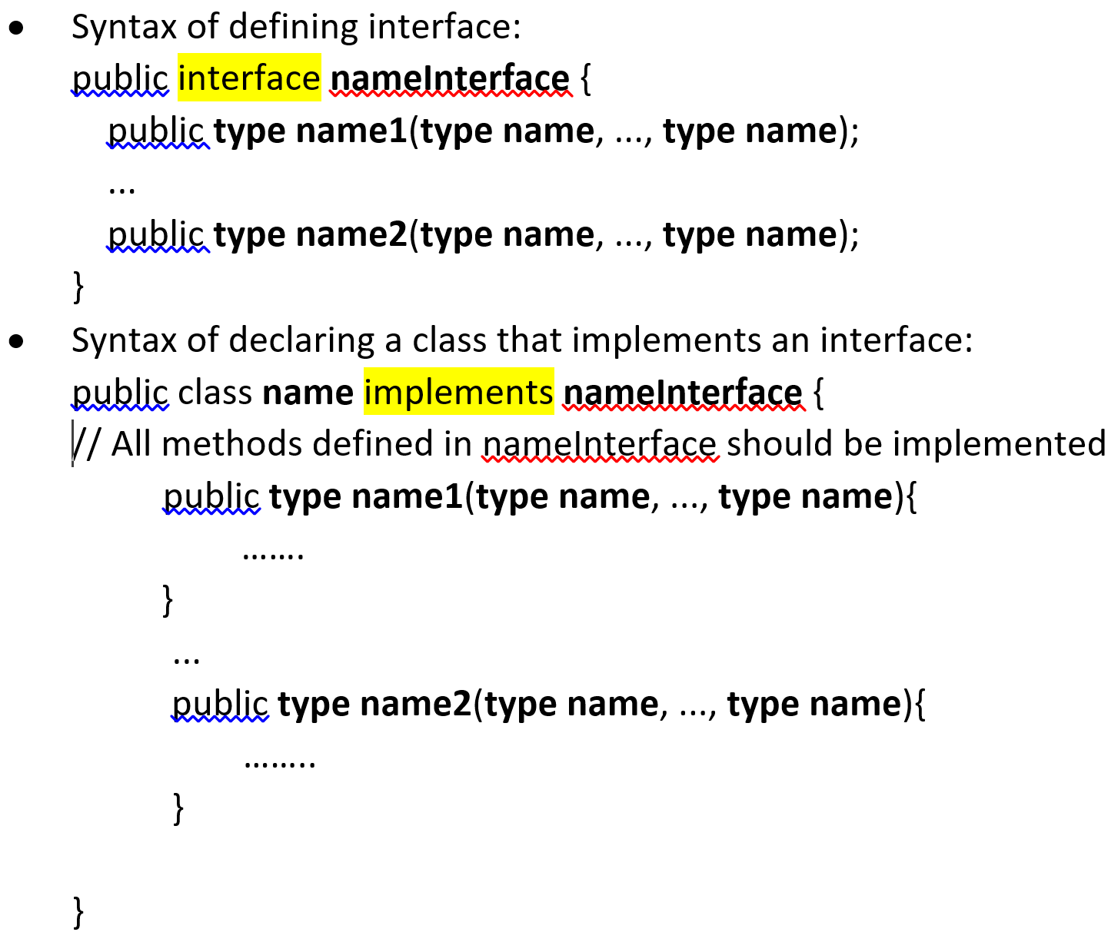

Slide 11
Generics

Slide 12
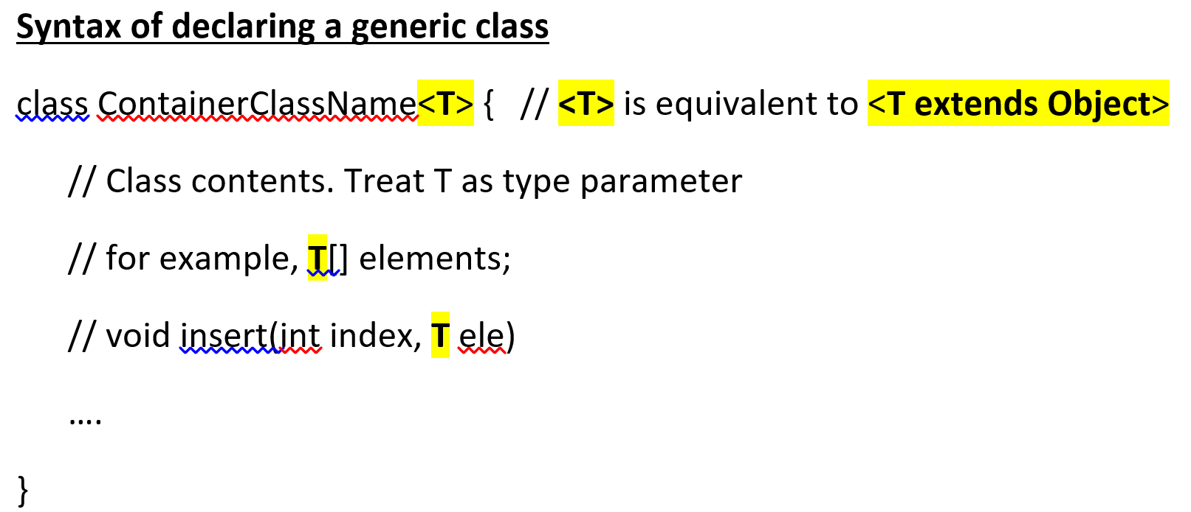
In the programming world, generics introduce the concept of type parameters to a programming language. It is most frequently used with collections and the methods that operate on them. Generics can be used for us to build a reusable, generic collection of data structures and algorithms.
If the code for each datatype is virtually identical, we could consider a generic class or a generic method.
T is the name of a placeholder for whatever type is specified when the list is created.
Invoking and instantiating a generic class
To reference the generic ContainerClassName class from within your code, you must perform a generic type invocation, which replaces T with some concrete value, such as Animal or Car:
ContainerClassName<Animal> list_of_animals;
ContainerClassName<Car> list_of_cars;

Slide 13
public class ItemCount <Type extends Comparable<Type>> {
private Type itemVal; // Value for item
private int itemCount; // Count for item
// Set item value, and reset item count to 0
public void setItem(Type newItemVal) {
itemVal = newItemVal;
itemCount = 0;
}
// Get item value
public Type getItem() {
return itemVal;
}
// Get item count
public int getCount() {
return itemCount;
}
// Reset item count to 0
public void resetCount() {
itemCount = 0;
}
// Reset item count to 0
public void incrementCount() {
++itemCount;
}
// Increments the item count if compareVal argument
// is equal to item value.
public void incrementIfDuplicate(Type compareVal) {
// FIXME: Complete method
}
// Returns string for item value and count using
// the format itemVal: itemCount
@Override
public String toString() {
return "" + itemVal + ": " + itemCount;
}
}
zyDE 1.10.1: Class generics.
The following program using a generic class ItemCount to count the number of times the same word is read from the user input. Modify the program to:
Complete the incrementIfDuplicate() method and update the main() method within the DuplicateCounter class to use the incrementIfDuplicate() method.
Modify the program to count the number of times a specific integer value is read from the user input. Be sure to use the Integer class.
Notes:
Question 17
https://www.polleverywhere.com/multiple_choice_polls/NWUHMrvHMWiJ7X5

Slide 14
zyDE 1.10.1: Class generics.
The following program using a generic class ItemCount to count the number of times the same word is read from the user input. Modify the program to:
Complete the incrementIfDuplicate() method and update the main() method within the DuplicateCounter class to use the incrementIfDuplicate() method.
Modify the program to count the number of times a specific integer value is read from the user input. Be sure to use the Integer class.
public class DuplicateCounter {
public static void main(String[] args) {
Scanner scnr = new Scanner(System.in);
ItemCount<String> wordCounter = new ItemCount<String>();
String inputWord;
wordCounter.setItem("that");
System.out.println("Enter words (END at end):");
// Read first word
inputWord = scnr.next();
// Keep reading until word read equals <end>
while( !inputWord.equals("END") ) {
if (wordCounter.getItem().compareTo(inputWord) == 0) {
wordCounter.incrementCount();
}
// Read next word
inputWord = scnr.next();
}
// Display final word count
System.out.println("The word \"" + wordCounter.getItem() +
"\" was read " + wordCounter.getCount() +
" times.");
}
}
Notes:
Question 17
https://www.polleverywhere.com/multiple_choice_polls/NWUHMrvHMWiJ7X5

Slide 15
X496: Inheritance - Sparrow
There exists an abstract class Bird.
public abstract class Bird {
public Bird() {}
public String eat() {
return "worms";
}
public abstract double fly();
}
Create a subclass of Bird called Sparrow. Overwrite the eat() method so that the Sparrow eats "seeds". Implement the fly() method so that it returns its altitude of 4.13 meters.
public class Sparrow //TODO
{
public Sparrow() {super();}
public String eat() {
//TODO
}
public double fly() {
//TODO
}
}

Slide 16
Questions for Collections, ADTs & Interface

Slide 17
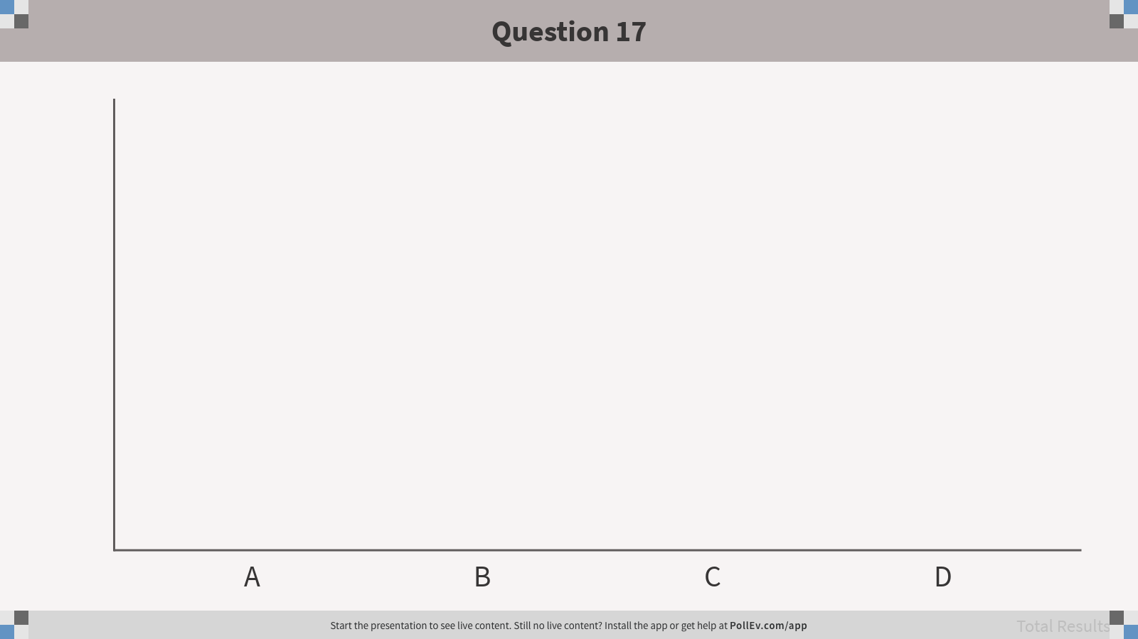
17. Collections in the Java framework can hold: A. Primitive types only
B. Java’s built-in objects only
C. Wrapped primitives only
D. Any kind of object
Notes:
Question 17
https://www.polleverywhere.com/multiple_choice_polls/NWUHMrvHMWiJ7X5

Slide 18
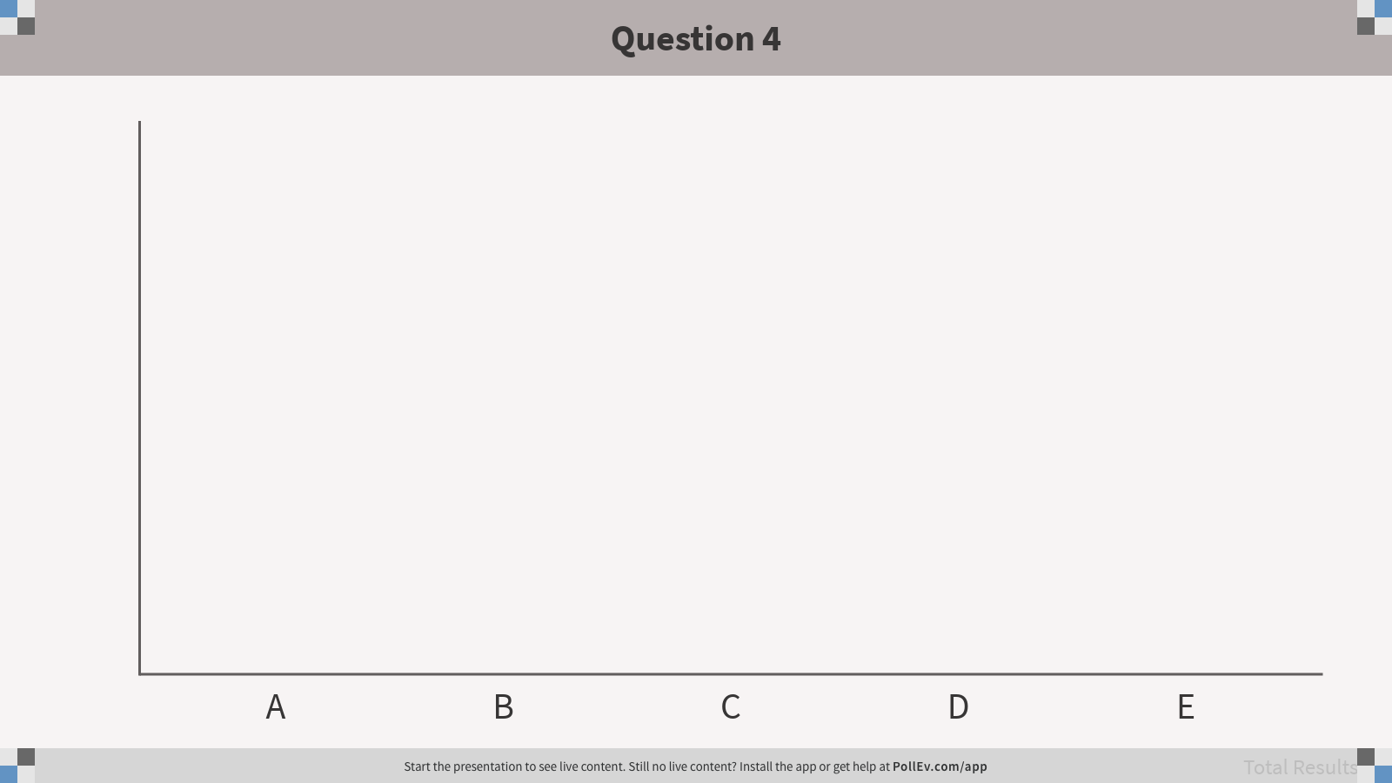
4. How do we access the last element in this array and put it into x? int[] table = {2, 4, 6, 8, 10, 12, 14};
int x = table[length];
int x = table[length - 1];
int x = table[7];
int x = table[table.length]
int x = table[table.length - 1];
Notes:
Question 4
https://www.polleverywhere.com/multiple_choice_polls/RC9SDMKQtvjANZwHwxEV9
Concepts: arrays

Slide 19

5. How do we access the last element added to this array and put it into x? int[] table = new int[20];
table[0] = 3;
table[1] = 8;
table[2] = 7;
int x = table[20];
int x = table[l19];
int x = table[2];
int x = table[table.length]
int x = table[table.length - 1];
Notes:
Question 5
https://www.polleverywhere.com/multiple_choice_polls/27lCH6w6mDls0dme0xE86
Concepts: arrays

Slide 20

9. What is printed as a result of the following code? ArrayList<String> myList = new ArrayList<>(); myList.add(“Jamal”); myList.add(“Trey”); myList.add(1, “Nala”); System.out.println(myList.get(2));
Jamal
Trey
Nala
[Jamal, Trey, Nala]
Notes:
Question 9
https://www.polleverywhere.com/multiple_choice_polls/4fycrM4hSmZCVQw
Java review: loops

Slide 21

10. What is the cost, in number of operations, of the last line of the following code?
ArrayList<Turtle> myTurtles = new ArrayList<Turtle>(110); for (int i = 0; i < 100; i++) { myTurtles.add(new Turtle()); } Turtle t = new Turtle(); myTurtles.add(0, t);
101
201
1
2
Notes:
Question 10
https://www.polleverywhere.com/multiple_choice_polls/QXrkNg3FvkpMjMk
Java review: nested loops

Slide 22

8. In Java, the ArrayList and LinkedList classes implement the List interface. Which of the following is valid?
List<String> ls = new ArrayList<>();
ArrayList<String> ls = new List<>();
List<> ls = new List<String>();
List<> ls = new ArrayList<String>();
Notes:
Question 8
https://www.polleverywhere.com/multiple_choice_polls/X8wOuBKtbsMCOed
Java review: static methods

Slide 23
Questions for Class Generics & Generic Methods

Slide 24

13. What goes in the blank?
ArrayList<Turtle> turtleRacers = new ArrayList<>();
… // add a bunch of turtles to the arraylist
for (_____ racer : turtleRacers) {
racer.forward((int)(Math.random()*20));
}
String
turtleRacers
Turtle
Object
Notes:
Question 13
https://www.polleverywhere.com/multiple_choice_polls/zoXvkaKN9smMxZf

